Slide 1
Introduction to History of Philosophy
Idea of History of Philosophy
Relevance of Studying History of Philosophy
Different Eras in History of Philosophy
Ancient Philosophy.
Medieval Philosophy.
Renaissance Philosophy.
Modern Philosophy

Slide 2
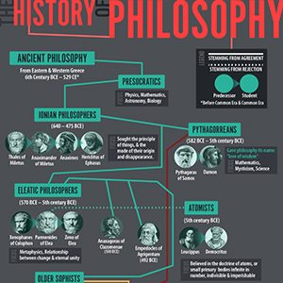

Slide 3
Idea of History of Philosophy
The history of philosophy is the history of how humans came to understand our world. By studying it we come to understand how and why we believe many of the things that we do.
It is the source for many of our problems as well as the basis of many proposed solutions.
It is a process through which change in the understanding the ideas of major philosophers and how the main ideas held by philosophers in different time periods have changed
the history of philosophy is what sets the table at which philosophers eat

Slide 4
Importance of History of Philosophy
Studying the history of philosophy is the best way to understand what philosophy is
the primary purpose of doing the history of philosophy is to pose new philosophical questions. Studying historical figures stimulates us to consider new problems and/or consider the same problems from new perspectives.
The history of philosophy is generally relevant to human affairs for the same reason that the history of anything is relevant.
The study of the history of philosophy is important for the understanding of one's self, and of the nature of human societies and of humanity as a whole.

Slide 5
it is best to approach philosophy through the historical perspective because, in so doing, you get to know the major moments in the development of thought. You also get to study the key players in this development.
studying The History of Philosophy will give the student a healthy respect for the difficulties involved in gaining a true account of reality, and not a desire to totally abandon all philosophical effort!
It also introduces and invites the student into a deeper love of certain philosophical areas, periods or specific philosophers.
studying the history of philosophy especially opens for one the perspective and possibility of knowing what to focus on - whether an era, say ancient philosophy, a movement, say existentialism, or a particular thinker, say Aristotle

Slide 6
Studying the history of philosophy is the best way of studying philosophy. Even a cursory reading of the history of philosophy of authors like F. Copelston, B. Russell, S. E. Stumpf, B. Mondin, and recently, W. Lawhead, would prove this beyond reasonable doubt.

